Slide 1
Task:-3Car Price Prediction with Machine Learning
Name:-Bushra Akram Salmani
Oasis Infobytes Internship

Slide 2
Problem Statement:-
The price of a car depends on many factors such as the brand, model year, mileage, horsepower, etc.
The goal of this project is to build a Machine Learning model that can predict the price of a car using these features.

Slide 3
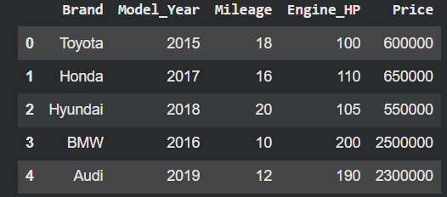
Dataset Description
Dataset Columns:
Brand
Model_Year
Mileage
Engine_HP
Price (Target)
Total Rows: 10
All values clean (no missing values)

Slide 4
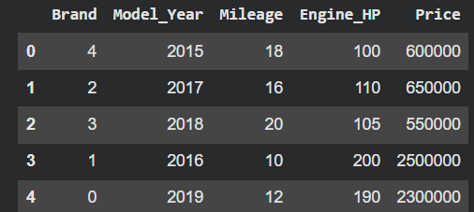
Data Preprocessing
What we did before training the model:
Converted Brand names → numbers (Label Encoding)
Selected features (X): Model_Year, Mileage, Engine_HP, Brand
Selected target (y): Price
Split dataset into Train & Test (80–20)

Slide 5

Model Used – Linear Regression
We used Linear Regression model because:
It works best for numerical prediction
Easy to understand and interpret
Gives high accuracy for this dataset
Code:
from sklearn.linear_model import LinearRegression
model = LinearRegression()
model.fit(X_train, y_train)

Slide 6
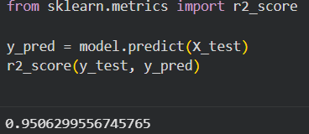
Model Accuracy
We evaluated the model using R² Score.
R² Score = 0.95

Slide 7
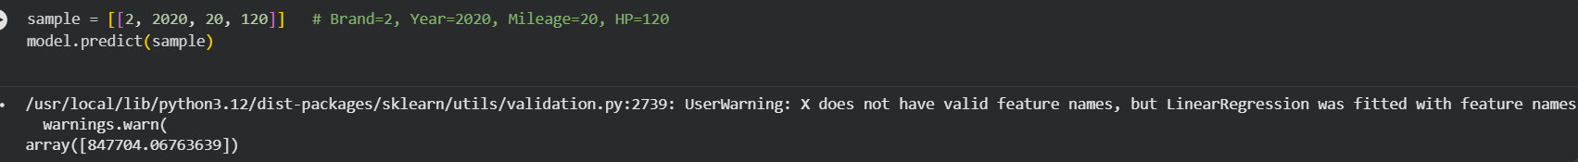
Prediction Example (Final Output)
Input values:
Model_Year = 2018
Mileage = 22
Engine_HP = 130
Brand = 2 (Honda, Toyota, etc based on your encoding)
Output:
Predicted Price: ₹ 8,47,704

Slide 8
Conclusion
The Linear Regression model performed very well with 95% accuracy
Car prices depend mainly on brand, year, mileage, and horsepower

